Slide 1
Using Ensemble Models to Determine if Diabetic Patients will be Readmitted within 30 Days
Darshan Patel
Fordham University
CISC 6930 – Data Mining – Fall 2018
Prof. Yijun Zhao

Slide 2
Objective
To use a variety of data mining concepts to create a binary classification model that predicts whether a diabetic patient will be readmitted to a hospital based on general features such as age, gender, medications, blood test result, medical specialty of physician, various diagnoses, etc.

Slide 3
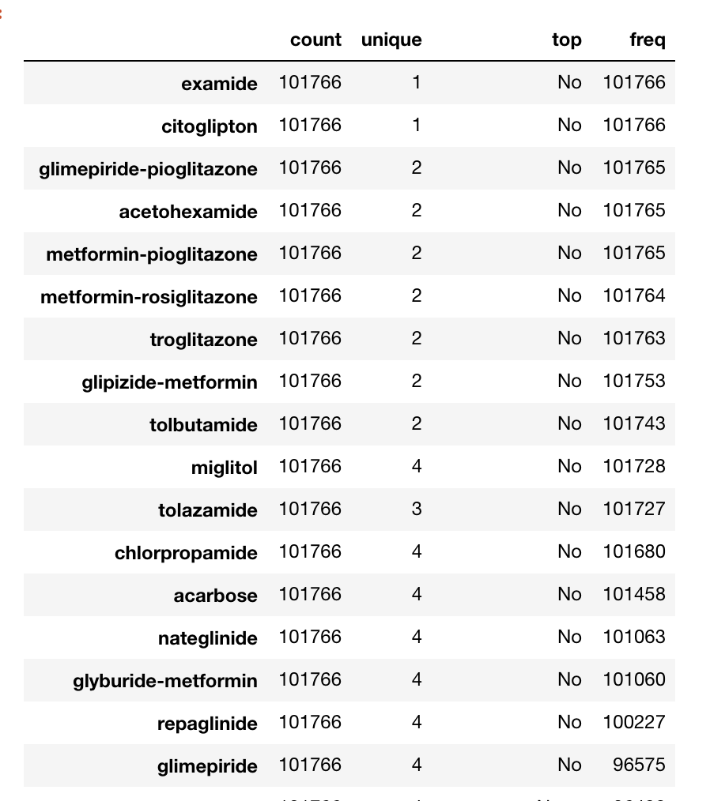
Data Cleaning
Remove features that were overly saturated, by 98%, with one attribute
Number of features reduced from 48 to 32.

Slide 4
Data Cleaning
Since there are 72 different medical specialties with the most common one being present in only 14.3% of the data, this feature was simplified. So if any specialty appears in the dataset with an occurrence of less than 0.5% percent, change it to other.
This reduced the number of medical specialty from 72 to 17.

Slide 5
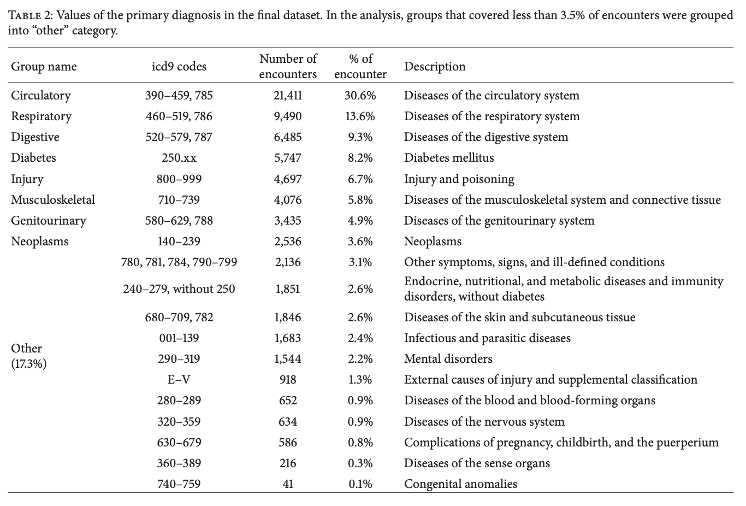
Data Cleaning
Simplify numerical diagnosis codes into one of 13 groups

Slide 6
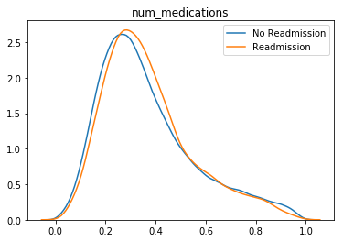
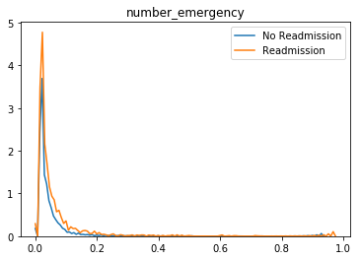
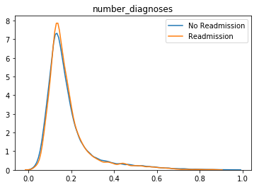
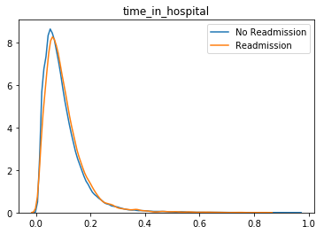
Preprocessing
Normalize all 8 nominal features.

Slide 7
Correlation of Continuous Features
There is high correlation between number of lab procedures and number of diagnoses. There is moderate correlation between number of medications and number of lab procedures.
Number of lab procedures and number of emergency visits were two of the least correlated features when compared to the other continuous features.

Slide 8
Preprocessing
Missing Values:
Weight – 96% missing
Payer code – 39% missing
Medical Specialty – 49% missing
Race, diag 1,2,3 - <3% missing
Drop weight feature.
Impute missing values for other features using random forest classifier.

Slide 9
Preprocessing
Feature selection was performed by choosing the top 33% of features that are correlated with the class label by the chi-square test of independence.
The categorical features were first dummified to binary features and then joined together with the continuous features to make a total of 185 features.
After feature selection, there was only 61 features.

Slide 10
Class Label Distribution
Number of Class 0: 90409
Number of Class 1: 11357
Nearly 8 times more observations of non-readmission than readmission within 30 days.
Solve imbalanced issue using SMOTE oversampling technique to bring both counts to 90409.

Slide 11
List of Classifiers
Perceptron
Naïve Bayes
Decision Tree
Linear Support Vector Classifier (SVM)
Extra Tree Classifier – ensemble of randomized trees where the best splits are made by random selection of features without replacement

Slide 12
Ensemble Models
Pick 3 of the 5 classifiers to create a voting classifier – this creates 10 individual ensemble models
For comparison only, create 5 models of 1 classifier only and an ensemble random forest classifier with default of 10 trees
Note: Use 10-Fold cross validation when creating all models and report the averaged test set accuracy and F1 score

Slide 15
Conclusion
SVC performed the worst, 30% accuracy, all other models had at least 50% accuracy
The ensemble model of naïve bayes, svc and extra tree was the worst performing ensemble model with 55% accuracy
Most ensemble models with a tree did better than 60% accuracy
Using only one decision tree yields 77% accuracy and F1 score
Random forest had the best accuracy and F1 score
Ensemble models of perceptron/naïve bayes, decision tree and extra tree did 2nd /3rd best in accuracy and F1 score (very close to RF)
Using an ensemble of all 5 features will actually hinder accuracy, just removing the decision tree and extra tree classifier will improve accuracy and F1 score

